Slide 1
Big Data Project - Hive

Slide 2
Import the SQL dump file in Cloudera MySQL Environment. mysql -u root -p healthcare < healthcare.sql
Import all tables from MySQL to hive.
sqoop import-all-tables –connect jdbc:mysql://localhost:3306/healthcare --username root --hive-import -m 1

Slide 3
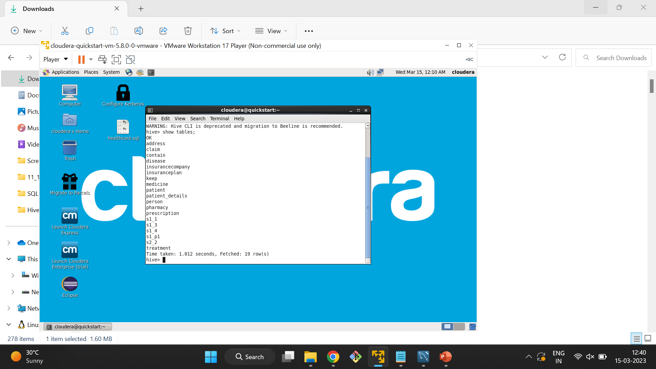

Slide 4
QS11)- /* Problem Statement 1: Jimmy, from the healthcare department, has requested a report that shows how the number of treatments each age category of patients has gone through in the year 2022. The age category is as follows, Children (00-14 years), Youth (15-24 years), Adults (25-64 years), and Seniors (65 years and over). Assist Jimmy in generating the report. */ SELECT COUNT(*), v1.category FROM (SELECT CASE WHEN YEAR(t1.date) - YEAR(dob) <= 14 THEN 'children' WHEN YEAR(t1.date) - YEAR(dob) <= 24 THEN 'youth' WHEN YEAR(t1.date) - YEAR(dob) <= 64 THEN 'adults' ELSE 'senior citizen' END AS category, p.patientid AS patientid FROM Patient p INNER JOIN treatment t1 ON p.patientid = t1.patientid WHERE YEAR(t1.date) = 2022) AS v1 GROUP BY v1.category; CREATE EXTERNAL TABLE IF NOT EXISTS s1_1 (counts int, category String) ROW FORMAT DELIMITED FIELDS TERMINATED BY ',' LINES TERMINATED BY '\n' LOCATION '/user/output';

Slide 5
insert overwrite table s1_1 SELECT COUNT(*), v1.category FROM (SELECT CASE WHEN YEAR(t1.date) - YEAR(dob) <= 14 THEN 'children' WHEN YEAR(t1.date) - YEAR(dob) <= 24 THEN 'youth' WHEN YEAR(t1.date) - YEAR(dob) <= 64 THEN 'adults' ELSE 'senior citizen' END AS category, p.patientid AS patientid FROM Patient p INNER JOIN treatment t1 ON p.patientid = t1.patientid WHERE YEAR(t1.date) = 2022) AS v1 GROUP BY v1.category; sqoop export --connect jdbc:mysql://localhost:3306/output --username root --P --table s1_1 --export-dir /user/output/000000_0 --input-fields-terminated-by ',';

Slide 6
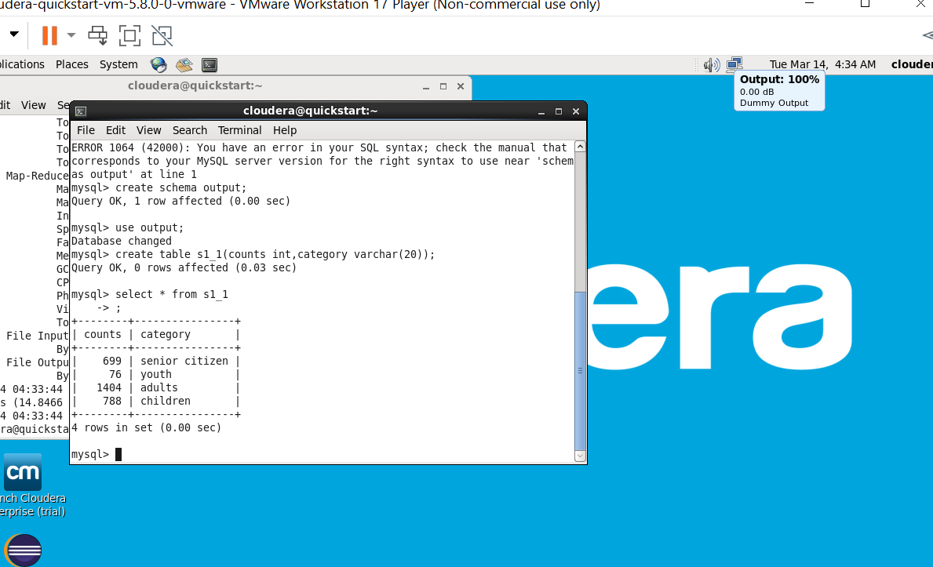

Slide 7
QS13)- /* Problem Statement 3: Jacob, from insurance management, has noticed that insurance claims are not made for all the treatments. He also wants to figure out if the gender of the patient has any impact on the insurance claim. Assist Jacob in this situation by generating a report that finds for each gender the number of treatments, number of claims, and treatment-to-claim ratio. And notice if there is a significant difference between the treatment-to-claim ratio of male and female patients. */ SELECT v11.gender,v11.TCount,v22.CCount,v11.TCount/v22.CCount as ratio FROM (SELECT p.gender as gender,count(v1.did) as TCount from person p join (SELECT t.patientid as pid,t.diseaseid as did FROM treatment t ) AS v1 ON p.personid=v1.pid GROUP BY p.gender)as v11 JOIN (SELECT p.gender as gender,count(v2.cid) as CCount from person p join (SELECT t.patientid as pid,c.claimid as cid FROM treatment t join claim c on t.claimid = c.claimid ) AS v2 ON p.personid=v2.pid GROUP BY p.gender) as v22 ON v11.gender = v22.gender; create external table s1_3 (gender varchar(50), total_count int, claim_count int, ratio double) row format delimited fields terminated by ',' lines terminated by '\n' location '/user/output/s1_3';

Slide 8
insert overwrite table s1_3 SELECT v11.gender,v11.TCount,v22.CCount,v11.TCount/v22.CCount as ratio FROM (SELECT p.gender as gender,count(v1.did) as TCount from person p join (SELECT t.patientid as pid,t.diseaseid as did FROM treatment t ) AS v1 ON p.personid=v1.pid GROUP BY p.gender)as v11 JOIN (SELECT p.gender as gender,count(v2.cid) as CCount from person p join (SELECT t.patientid as pid,c.claimid as cid FROM treatment t join claim c on t.claimid = c.claimid ) AS v2 ON p.personid=v2.pid GROUP BY p.gender) as v22 ON v11.gender = v22.gender; sqoop export --connect jdbc:mysql://localhost:3306/output --username root --password cloudera --table s1_3 --export-dir /user/output/s1_3/000000_0 --input-fields-terminated-by ',';

Slide 9
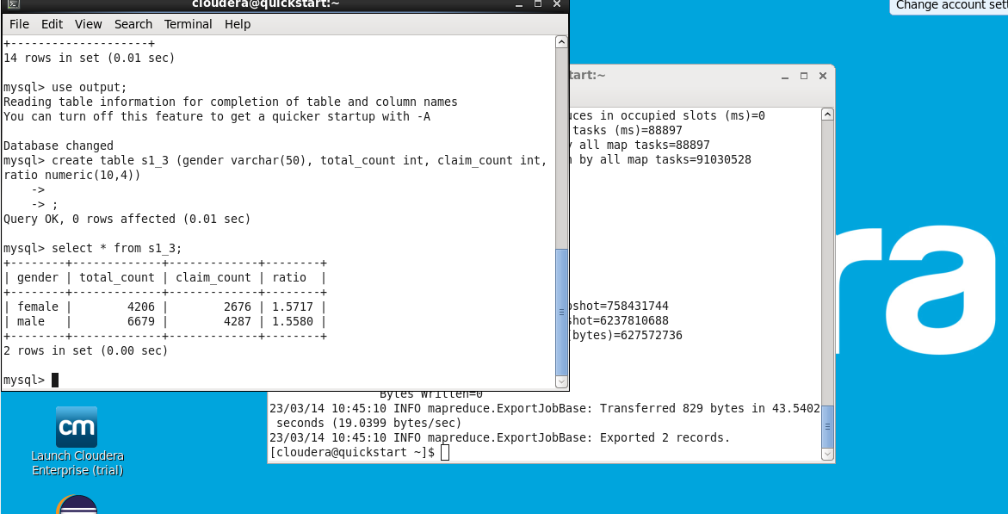

Slide 10
QS14)- /* Problem Statement 4: The Healthcare department wants a report about the inventory of pharmacies. Generate a report on their behalf that shows how many units of medicine each pharmacy has in their inventory, the total maximum retail price of those medicines, and the total price of all the medicines after discount. Note: discount field in keep signifies the percentage of discount on the maximum price. */ SELECT pharmacyname,count(v1.medicineID),sum(v1.maxprice),sum(v1.discount_price) FROM pharmacy INNER JOIN (SELECT k.pharmacyid,m.medicineID,m.maxprice,m.maxprice-(m.maxprice*(k.discount/100)) AS discount_price FROM keep k INNER JOIN medicine m on m.medicineid=k.medicineid ) AS v1 ON pharmacy.pharmacyid = v1.pharmacyid GROUP BY pharmacyname; create external table s1_4 (pharmacyname varchar(50),count int, sum_max double, sum_discount double) row format delimited fields terminated by ',' lines terminated by '\n' location '/user/output/s1_4';

Slide 11
insert overwrite table s1_4 SELECT pharmacyname,count(v1.medicineID),sum(v1.maxprice),sum(v1.discount_price) FROM pharmacy INNER JOIN (SELECT k.pharmacyid,m.medicineID,m.maxprice,m.maxprice-(m.maxprice*(k.discount/100)) AS discount_price FROM keep k INNER JOIN medicine m on m.medicineid=k.medicineid ) AS v1 ON pharmacy.pharmacyid = v1.pharmacyid GROUP BY pharmacyname; create table s1_4 (pharmacyname varchar(50),count int, sum_max numeric(10,2), sum_discount numeric(10,4)) sqoop export --connect jdbc:mysql://localhost:3306/output --username root --password cloudera --table s1_4 --export-dir /user/output/s1_4/000000_0 --input-fields-terminated-by ',';

Slide 12
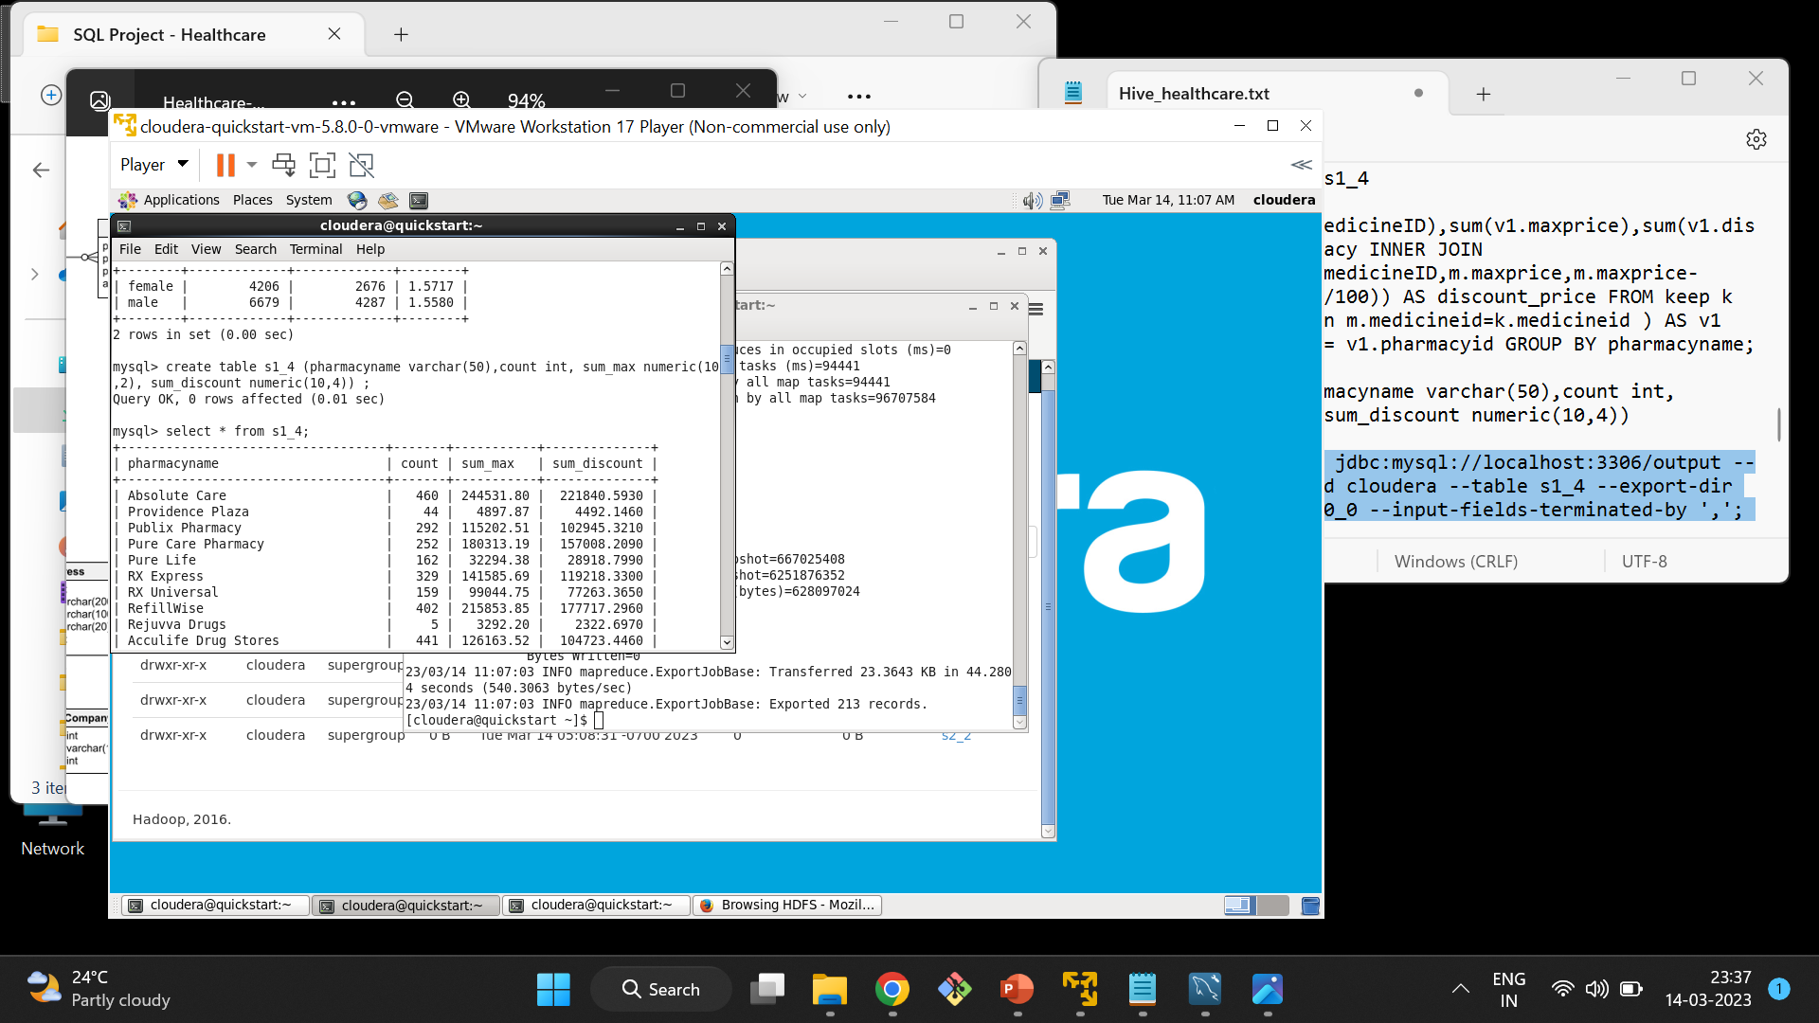

Slide 13
QS22)- /* Problem Statement 2: The State of Alabama (AL) is trying to manage its healthcare resources more efficiently. For each city in their state, they need to identify the disease for which the maximum number of patients have gone for treatment. Assist the state for this purpose. Note: The state of Alabama is represented as AL in Address Table. */ select diseasename,COUNT(IF(gender = 'male', 1, null)) count_male, COUNT(IF(gender = 'female', 1, NULL)) count_female, COUNT(IF(gender = 'male', 1, NULL))/COUNT(IF(gender = 'female', 1, NULL)) as ratio from disease join treatment on treatment.diseaseid=disease.diseaseid join patient on patient.patientid=treatment.patientid join person on patient.patientid=person.personid group by diseasename order by diseasename ; create external table s2_2 (diseasename varchar(50), malecount int, femalecount int, malefemale double) comment 'diseasename count' row format delimited fields terminated by ',' lines terminated by '\n' location '/user/output/s2_2';

Slide 14
INSERT OVERWRITE TABLE S2_2 select diseasename,COUNT(IF(gender = 'male', 1, null)) count_male, COUNT(IF(gender = 'female', 1, NULL)) count_female, COUNT(IF(gender = 'male', 1, NULL))/COUNT(IF(gender = 'female', 1, NULL)) as ratio from disease join treatment on treatment.diseaseid=disease.diseaseid join patient on patient.patientid=treatment.patientid join person on patient.patientid=person.personid group by diseasename order by diseasename ; sqoop export --connect jdbc:mysql://localhost:3306/output --username root --P --table s2_2 --export-dir /user/output/S2_2/000000_0 --input-fields-terminated-by ',';

Slide 15
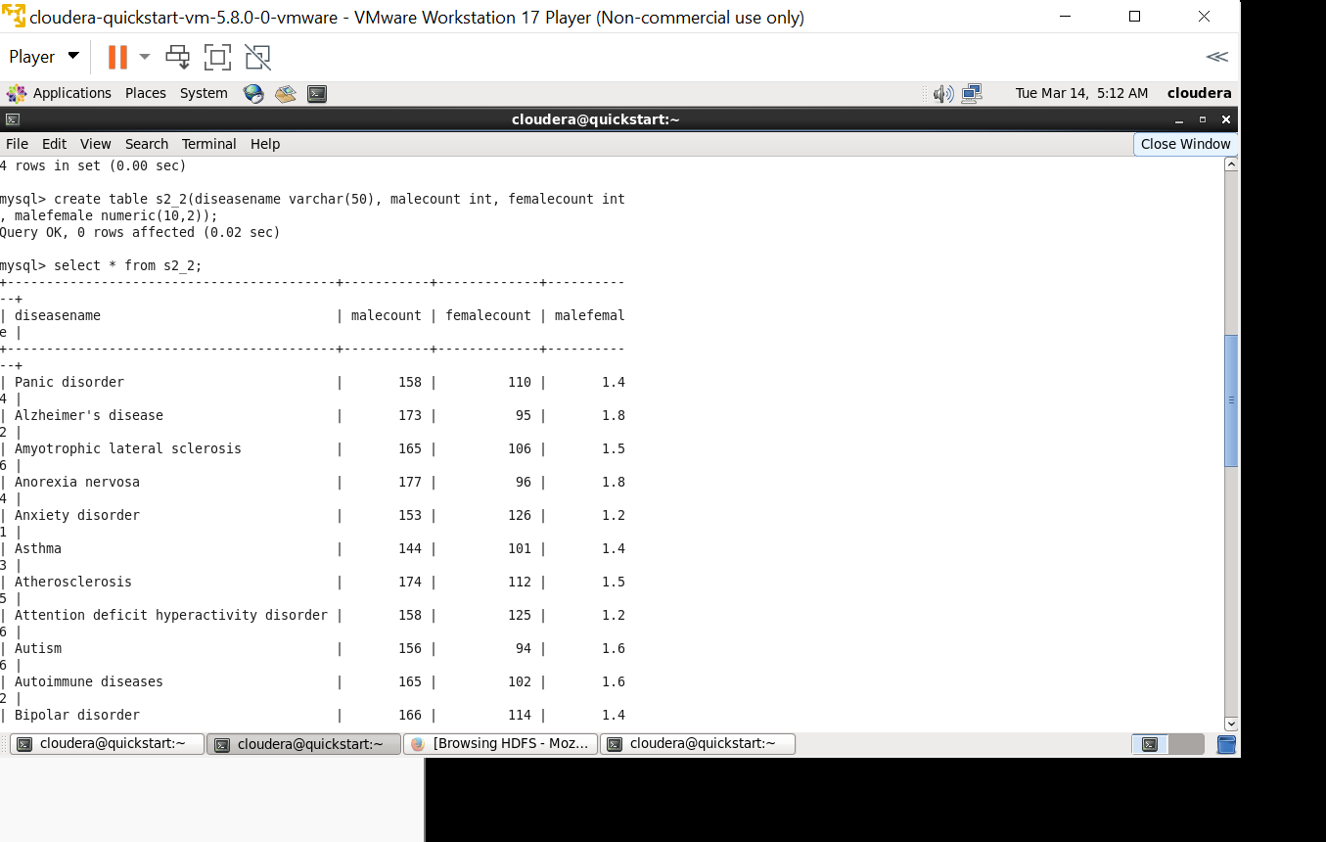

Slide 16
Q25)- /* Problem Statement 5: An Insurance company wants a state wise report of the treatments to claim ratio between 1st April 2021 and 31st March 2022 (days both included). Assist them to create such a report. */ WITH cte AS ( SELECT t.treatmentid AS t1,c.claimid AS c1,address_part1.state FROM address_part1 JOIN person ON address_part1.addressid=person.addressid JOIN patient ON patient.patientid=person.personid JOIN treatment t ON t.patientid=patient.patientid LEFT JOIN claim c ON t.claimid=c.claimid ) SELECT state, COUNT(t1), COUNT(c1), COUNT(t1)/COUNT(c1) AS Ratio FROM cte GROUP BY state; create external table s2_5 (state varchar(50),tcount int,ccount int ,ratio double) row format delimited fields terminated by ',' lines terminated by '\n' location '/user/output/s2_5';

Slide 17
with cte as (SELECT t.treatmentid AS t1,c.claimid AS c1,address_part1.state FROM address_part1 JOIN person ON address_part1.addressid=person.addressid JOIN patient ON patient.patientid=person.personid JOIN treatment t ON t.patientid=patient.patientid LEFT JOIN claim c ON t.claimid=c.claimid ) insert overwrite table s2_5 SELECT state, COUNT(t1), COUNT(c1), COUNT(t1)/COUNT(c1) AS Ratio FROM cte GROUP BY state; sqoop export --connect jdbc:mysql://localhost:3306/output --username root --password cloudera --table s2_5 --export-dir /user/output/s2_5/000000_0 --input-fields-terminated-by ',';

Slide 18
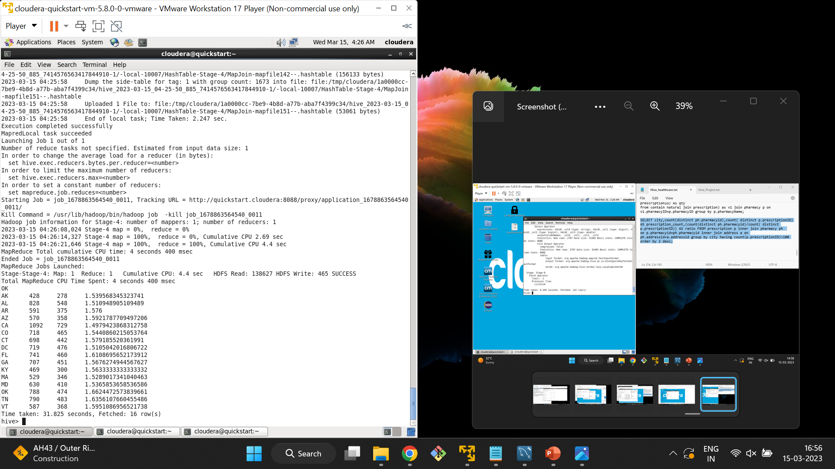
Before Partition:- It took 31.825 seconds

Slide 19
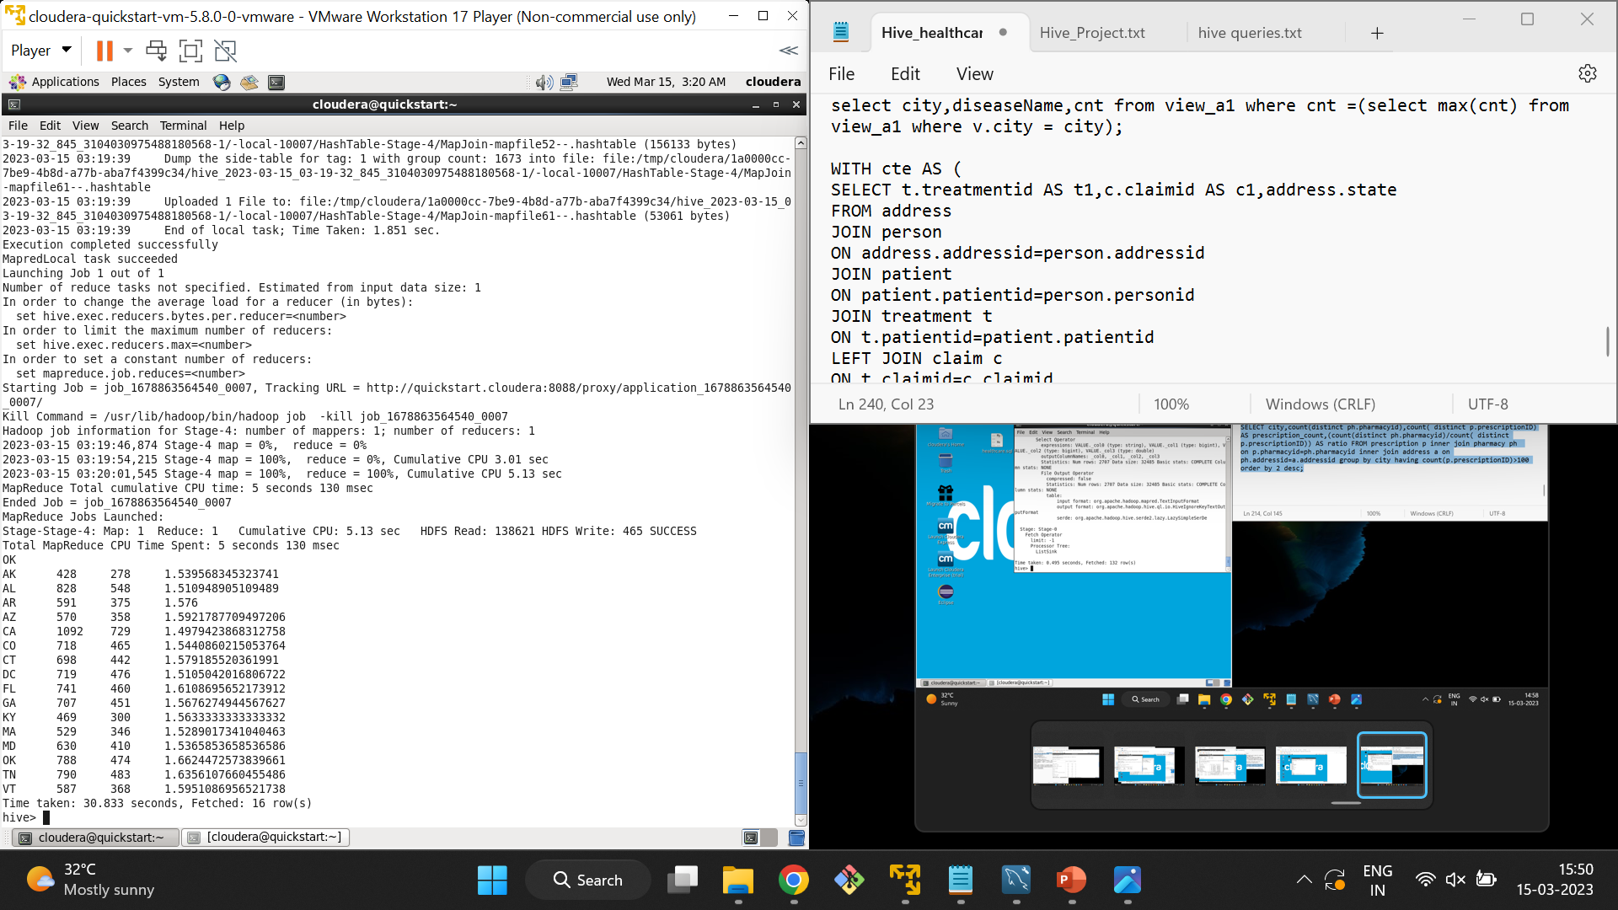
After partition:- It took 30.833 seconds

Slide 20


Slide 21
QS41)- select a.state,count(*) from treatment t left join claim c on t.claimid=c.claimid left join patient p on t.patientid=p.patientid left join person pe on p.patientid=pe.personid left join address_part1 a on pe.addressid=a.addressid where t.claimid IS NULL group by a.state; create external table s4_1 (state varchar(50),count int) row format delimited fields terminated by ',' lines terminated by '\n' location '/user/output/s4_1';

Slide 22
insert overwrite table s4_1 select a.state,count(*) from treatment t left join claim c on t.claimid=c.claimid left join patient p on t.patientid=p.patientid left join person pe on p.patientid=pe.personid left join address_part1 a on pe.addressid=a.addressid where t.claimid IS NULL group by a.state; sqoop export --connect jdbc:mysql://localhost:3306/output --username root --password cloudera --table s4_1 --export-dir /user/output/s4_1/000000_0 --input-fields-terminated-by ',';

Slide 23
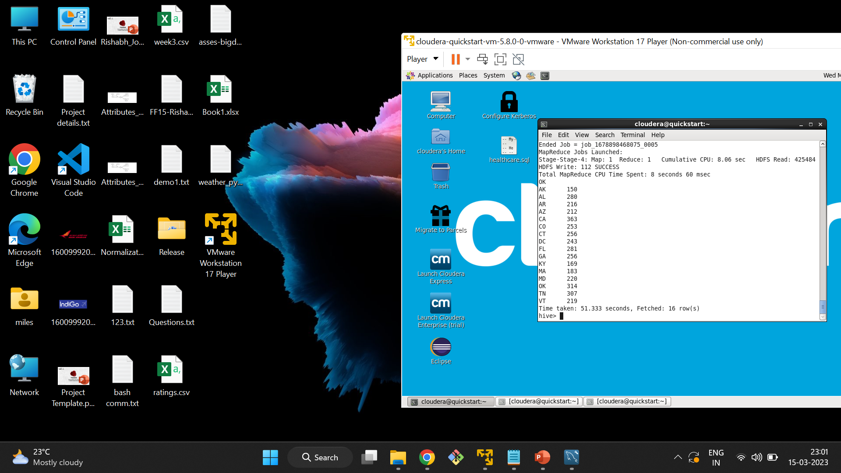
Before Partition:- It took 51.333 seconds

Slide 24

After Partition:- It took 45.151 seconds

Slide 25
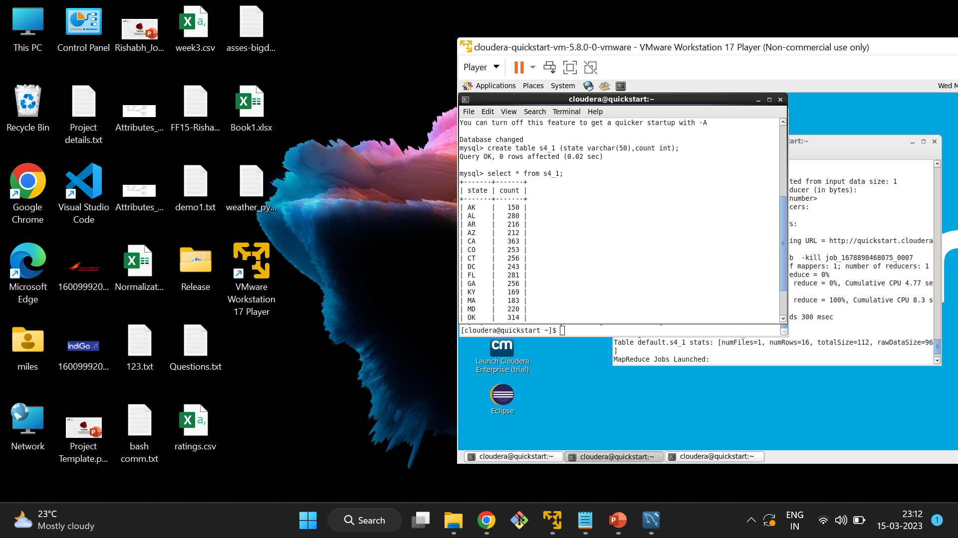

Slide 26
Q12)- select diseasename,COUNT(IF(gender = 'male', 1, null)) count_male, COUNT(IF(gender = 'female', 1, NULL)) count_female, COUNT(IF(gender = 'male', 1, NULL))/COUNT(IF(gender = 'female', 1, NULL)) as ratio from disease join treatment on treatment.diseaseid=disease.diseaseid join patient on patient.patientid=treatment.patientid join person on patient.patientid=person.personid group by diseasename order by diseasename ; create external table s1_2 (disease varchar(50),m_count int,f_count int,m_f_count double) row format delimited fields terminated by ',' lines terminated by '\n' location '/user/output/s1_2';

Slide 27
insert overwrite table s1_2 select diseasename,COUNT(IF(gender = 'male', 1, null)) count_male, COUNT(IF(gender = 'female', 1, NULL)) count_female, COUNT(IF(gender = 'male', 1, NULL))/COUNT(IF(gender = 'female', 1, NULL)) as ratio from disease join treatment on treatment.diseaseid=disease.diseaseid join patient on patient.patientid=treatment.patientid join person on patient.patientid=person.personid group by diseasename order by diseasename ; sqoop export --connect jdbc:mysql://localhost:3306/output --username root --password cloudera --table s1_2 --export-dir /user/output/s1_2/000000_0 --input-fields-terminated-by ',';

Slide 28
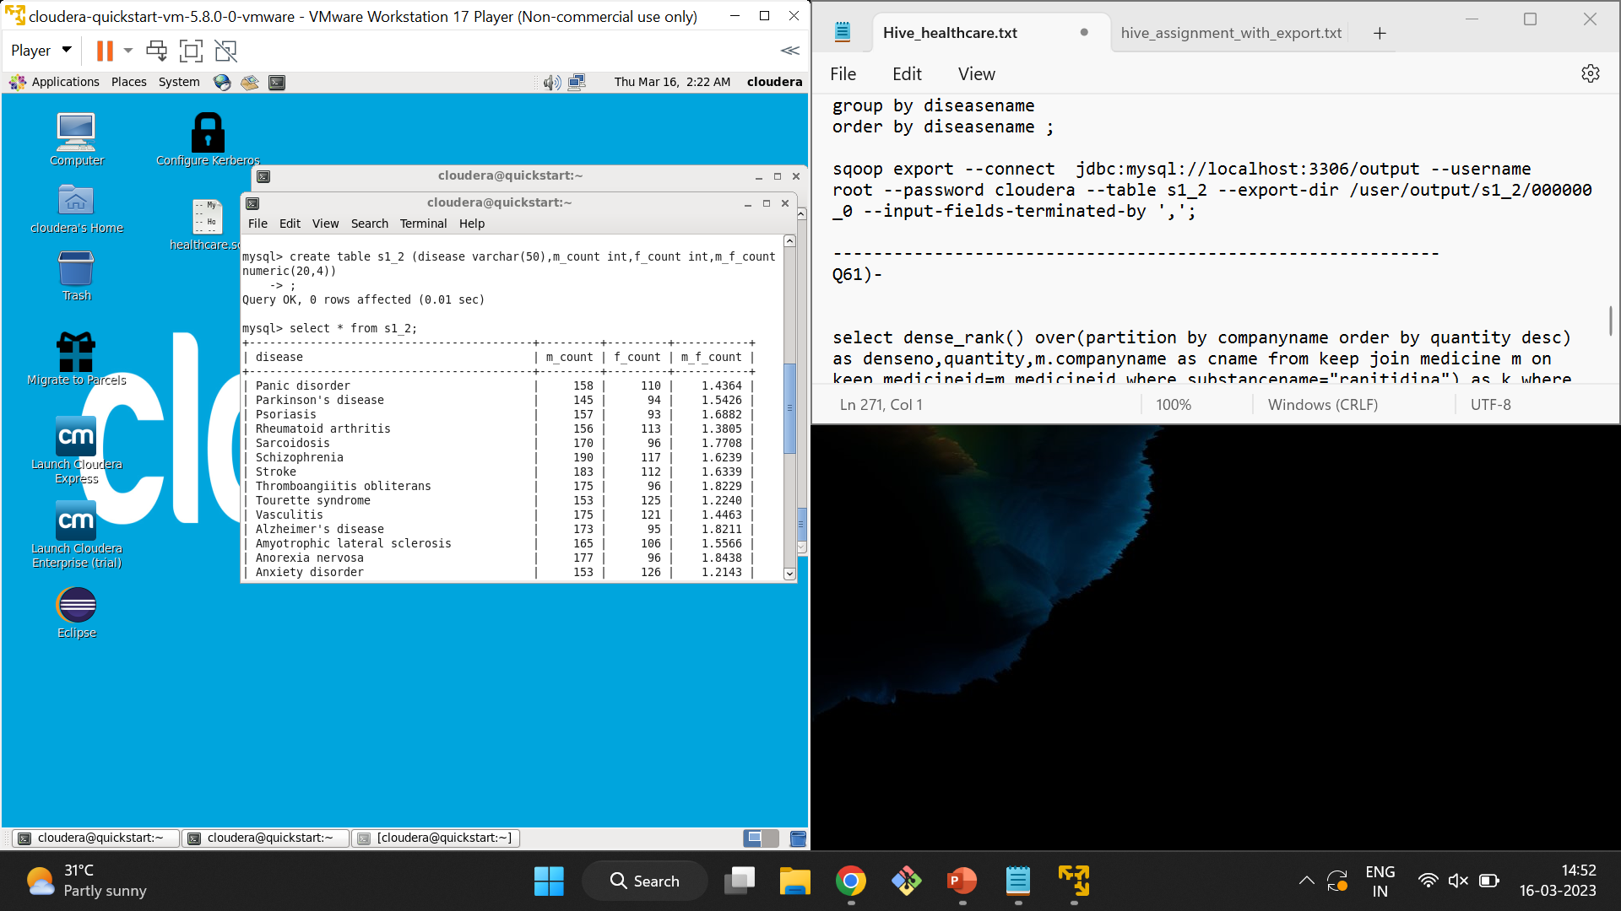

Slide 29
Q64)- select a.state,count(*) from treatment t left join claim c on t.claimid=c.claimid left join patient p on t.patientid=p.patientid left join person pe on p.patientid=pe.personid left join address a on pe.addressid=a.addressid where t.claimid IS NULL group by a.state; create external table s6_4 (state varchar(50),count int) row format delimited fields terminated by ',' lines terminated by '\n' location '/user/output/s6_4';

Slide 30
insert overwrite table s6_4 select a.state,count(*) from treatment t left join claim c on t.claimid=c.claimid left join patient p on t.patientid=p.patientid left join person pe on p.patientid=pe.personid left join address a on pe.addressid=a.addressid where t.claimid IS NULL group by a.state; sqoop export --connect jdbc:mysql://localhost:3306/output --username root --password cloudera --table s6_4 --export-dir /user/output/s6_4/000000_0 --input-fields-terminated-by ',';

Slide 31
